Slide 1



NEAR EAST UNIVERSITY
Institute of Graduate Studies | Department of Artificial Intelligence Engineering | Master of Science
Design and Evaluation of HiveSentinel AI:
A Multi-Platform System for Bee Pest Monitoring
M.Sc. Thesis Defense Presentation | Nicosia , June 2026
Muhammed Murat Yanaşoğlu
M.Sc. Artificial Intelligence Engineering | Near East University
Student Number: 20245073
https://muratyanasoglu.com/ | 20245073@std.neu.edu.tr | eng.muratyanasoglu@gmail.com | +905338324602

Slide 2
Presentation Outline
1
1. Research background, problem statement, and objectives
2
2. HiveSentinel AI system overview and methodology
3
3. Dataset, validation strategy, and implementation layers
4
4. Main results: web platform, desktop-local model, and edge runtime
5
5. Discussion, comparison with literature, and research question answers
6
6. Limitations, contributions, future work, and conclusion
Focus: key findings, defensible evidence, and bounded claims
Design and Evaluation of HiveSentinel AI: A Multi-Platform System for Bee Pest Monitoring | Muhammed Murat Yanaşoğlu | Master Thesis Defence
2

Slide 3
Background and Motivation
Apiculture Need
Technology Opportunity
Practical Constraint
Bee health monitoring is increasingly important due to invasive pests, predatory insects, and delayed reaction to field changes.
Manual monitoring and incomplete digital tools create inconsistency, delay, and weak traceability.
Recent advances in computer vision and deep learning make automated insect recognition increasingly feasible.
Useful field systems require more than a model: they also need software layers, operational controls, and runtime safety mechanisms.
Deployment must remain effective under limited connectivity, local inference needs, and low-resource hardware.
A defensible system must be demonstrable, reproducible, and suitable for online/offline contexts.
Motivating question: How can bee pest monitoring be implemented as a traceable, multi-platform AI system rather than as an isolated classifier?
Design and Evaluation of HiveSentinel AI: A Multi-Platform System for Bee Pest Monitoring | Muhammed Murat Yanaşoğlu | Master Thesis Defence
3

Slide 4
Problem Statement, Objectives, and Research Questions
Problem and Study Aim
Research Questions (RQ1–RQ5)
Problem: The absence of a complete, integrated, reproducible, and constraint-aware AI framework for bee pest monitoring validated across deployment levels.
Aim: To create, implement, and evaluate HiveSentinel AI as a cross-platform bee pest monitoring system with web, desktop-local, and edge-local components.
Purpose: To assess system architecture, model behavior, reproducibility, and the operational limits of edge software within a structured evidence framework.
RQ1: Can a web-based application and AI pipeline work together to provide a complete monitoring workflow?
RQ2: How well does a desktop-based local model perform classification on the project dataset, and what does this mean in practice?
RQ3: Can the system operate offline with a stable API and measurable stress-performance tradeoffs?
RQ4: Is a Raspberry Pi-based runtime feasible if inference requests are controlled through rate limiting?
RQ5: What additional requirements must be satisfied before validated physical edge performance can be claimed on Raspberry Pi 4 hardware?
Key research gaps addressed
• Integration gap
• Traceability gap
• Deployment gap
• Domain translation gap
Design and Evaluation of HiveSentinel AI: A Multi-Platform System for Bee Pest Monitoring | Muhammed Murat Yanaşoğlu | Master Thesis Defence
4

Slide 5
HiveSentinel AI Overview and Significance
Web Platform
Desktop Local Model
Edge Runtime
User-facing monitoring and workflow layer
Browser and server stack
Validation: build/API/auth probes
Training, evaluation, and local inference pipeline
Laptop/desktop host
Validation: dataset integrity, Phase 3 metrics, stress benchmark
ONNX/Flask inference for low-resource devices
Raspberry Pi-class target
Validation: package checks, paced API sweep, rate-limit probe
Why the study matters
Scholarship
Technology
Practice
Documents how AI systems can be constructed, integrated, and evaluated across software layers.
Shows interaction among training, APIs, local inference, and operational constraints.
Supports earlier detection of hive-related threats while separating software evidence from field evidence responsibly.
Design and Evaluation of HiveSentinel AI: A Multi-Platform System for Bee Pest Monitoring | Muhammed Murat Yanaşoğlu | Master Thesis Defence
5

Slide 6
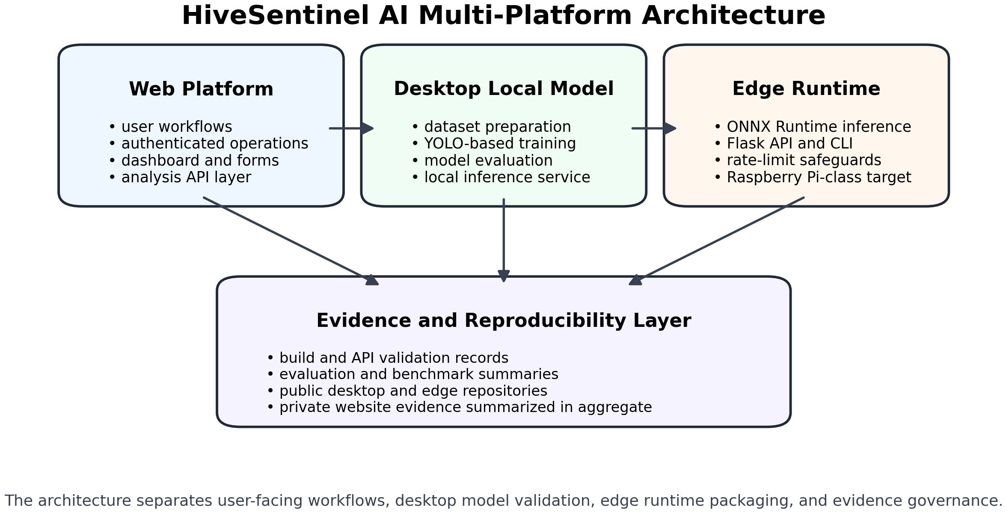
System Architecture
Figure 1 from the thesis
Interpretation
Application layer: Next.js-based website services and user workflows.
Model lifecycle layer: dataset preparation, training runs, evaluations, and production weights.
Edge runtime layer: ONNX models served via CLI and Flask with input and rate limits.
Evidence layer: result files, metric snapshots, logs, and reproducibility artifacts across all three components.
Integration is configuration-dependent; the thesis does not claim that every live deployment always routes through all layers simultaneously.
Figure 1. Multi-platform system architecture of HiveSentinel AI
Design and Evaluation of HiveSentinel AI: A Multi-Platform System for Bee Pest Monitoring | Muhammed Murat Yanaşoğlu | Master Thesis Defence
6

Slide 7
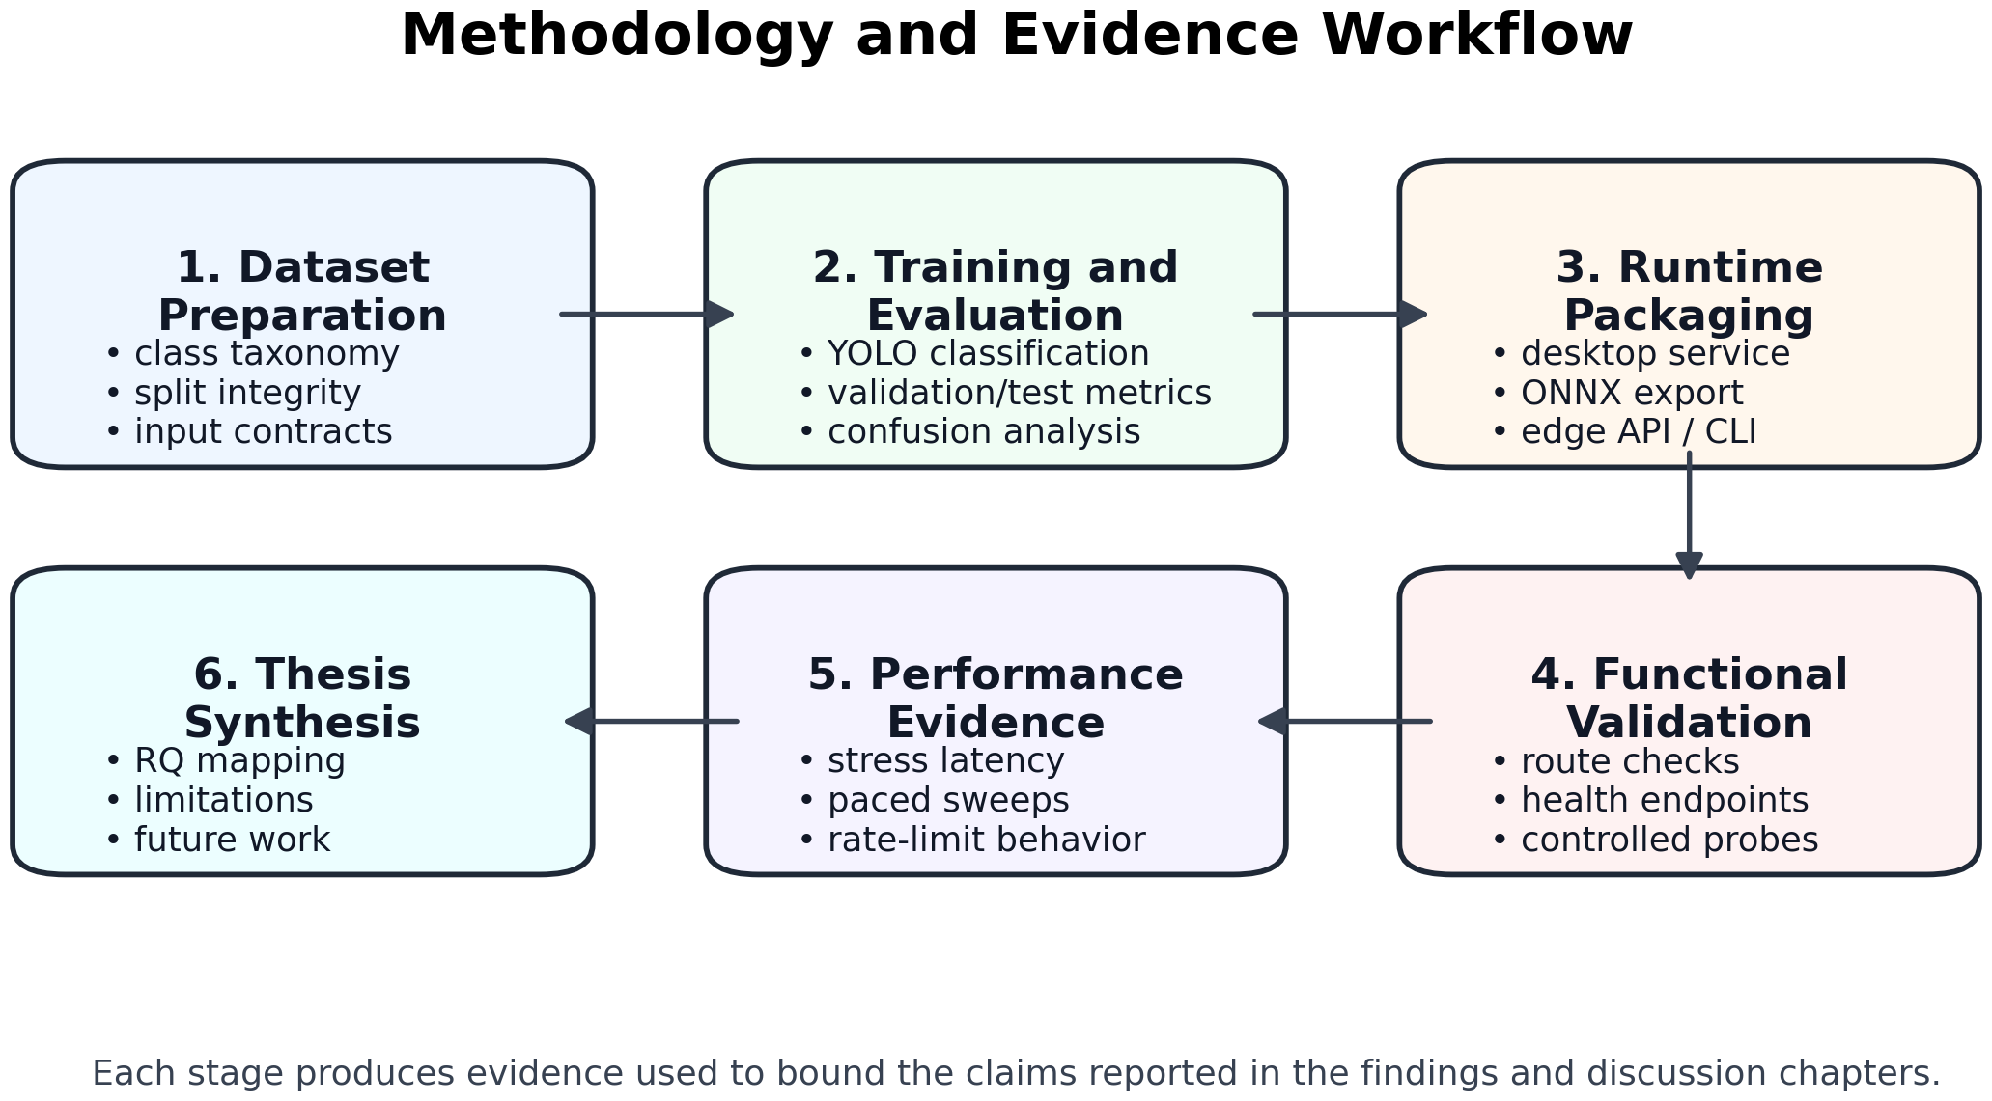
Methodology and Evidence Workflow
Design-and-evaluation approach
Methodological Notes
Research design: implementation-oriented design-and-evaluation study.
Three interrelated layers: web platform, desktop-local AI pipeline, and low-resource edge runtime.
Evidence is grounded in versioned project documents, dataset summaries, model configurations, evaluation outputs, API validations, and runtime logs.
Desktop-local and edge-runtime tracks are treated separately to avoid confusion between validation-split results, example-image diagnostics, and hardware-field claims.
Figure 4. Methodology and evidence workflow
Design and Evaluation of HiveSentinel AI: A Multi-Platform System for Bee Pest Monitoring | Muhammed Murat Yanaşoğlu | Master Thesis Defence
7

Slide 8
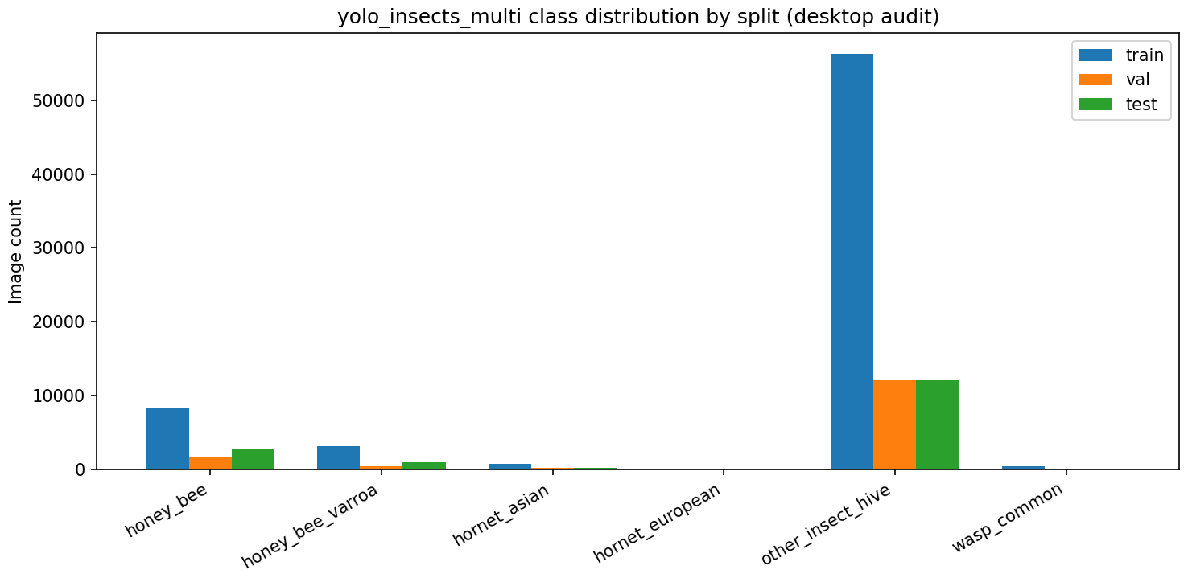
Dataset and Class Taxonomy
99,067
Total images
68,774
Train
14,376
Validation
15,917
Test
Class distribution summary
Split distribution by class
Class | Total
honey_bee | 12,570
honey_bee_varroa | 4,500
hornet_asian | 996
hornet_european | 29
other_insect_hive | 80,425
wasp_common | 547
Figure 2. yolo_insects_multi class distribution by split
Dataset classes: honey_bee, honey_bee_varroa, hornet_asian, hornet_european, other_insect_hive, and wasp_common.
Design and Evaluation of HiveSentinel AI: A Multi-Platform System for Bee Pest Monitoring | Muhammed Murat Yanaşoğlu | Master Thesis Defence
8

Slide 9
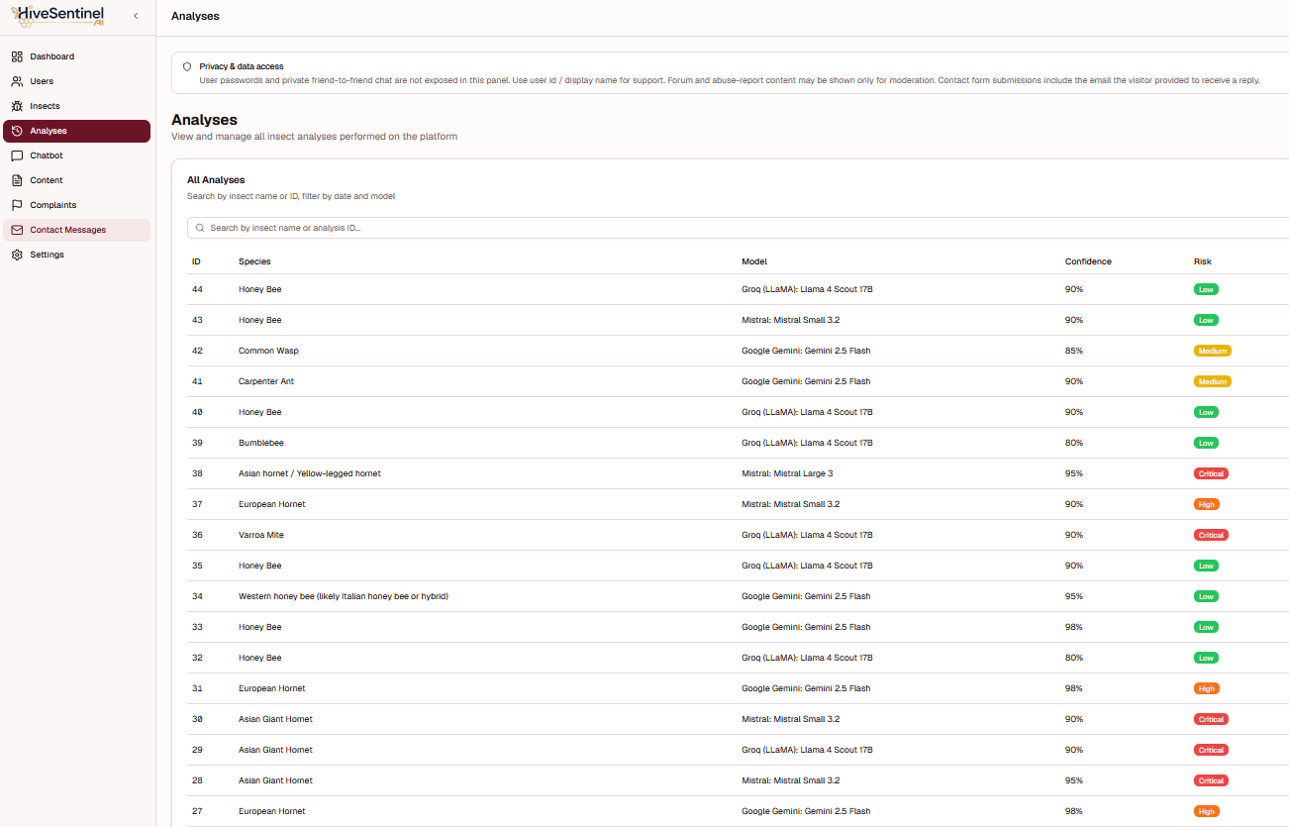
Web Platform and Application-Layer Findings
Implemented workflow capabilities
Selected interface evidence
• Authenticated analysis workflows for AI-supported image assessment.
• Personal dashboard, analysis history, and exportable records.
• Parallel model comparison, public guidance chatbot, learning hub, and localization layer.
• Collaboration features: friends, direct messaging, notifications, and forum sharing.
• Administrative functions: analytics, moderation, user management, and knowledge-base curation.
• Validation evidence: lint/tsc completed, production build completed, Prisma database initialization completed.
Appendix B - Figure B5. Web interface screenshot: administrative analysis records listing view.
Design and Evaluation of HiveSentinel AI: A Multi-Platform System for Bee Pest Monitoring | Muhammed Murat Yanaşoğlu | Master Thesis Defence
9

Slide 10
Validation Strategy Aligned to Research Questions
Research question grounding in Chapter IV
RQ1
Web build, route, mutation, and analysis-endpoint evidence
RQ2
Dataset integrity, Phase 3 metrics, confusion/threshold artifacts
RQ3
Desktop stress tests, health/dashboard summaries, website stress log
RQ4
Pytest, ONNX/Flask metrics, paced sweep, rate-limit probe
RQ5
Remaining physical Raspberry Pi 4 requirements and explicit field-protocol boundary
The thesis uses engineering evidence rather than formal null-hypothesis testing.
Design and Evaluation of HiveSentinel AI: A Multi-Platform System for Bee Pest Monitoring | Muhammed Murat Yanaşoğlu | Master Thesis Defence
10

Slide 11
Desktop-Local Model: Main Validation Results
0.96675
Top-1 validation accuracy
0.9680
Weighted F1-score
0.6776
Macro F1-score
14,376
Validation images
Interpretation of Table 10
Selected class-level observations from Table 9
Evaluation scope: the full validation split, not the official test split.
Weighted metrics are strong because high-support classes dominate the dataset.
Macro metrics are lower because rare classes are unstable and much more sensitive to imbalance.
The thesis explicitly treats these values as validation-split evidence rather than universal field performance.
Class | Precision | Recall | F1 | Support
honey_bee | 0.8901 | 0.9257 | 0.9076 | 1,628
honey_bee_varroa | 0.9666 | 0.7694 | 0.8568 | 451
other_insect_hive | 0.9897 | 0.9819 | 0.9858 | 12,063
wasp_common | 0.3832 | 0.7805 | 0.5141 | 82
hornet_european | 0.0000 | 0.0000 | 0.0000 | 4
Design and Evaluation of HiveSentinel AI: A Multi-Platform System for Bee Pest Monitoring | Muhammed Murat Yanaşoğlu | Master Thesis Defence
11

Slide 12
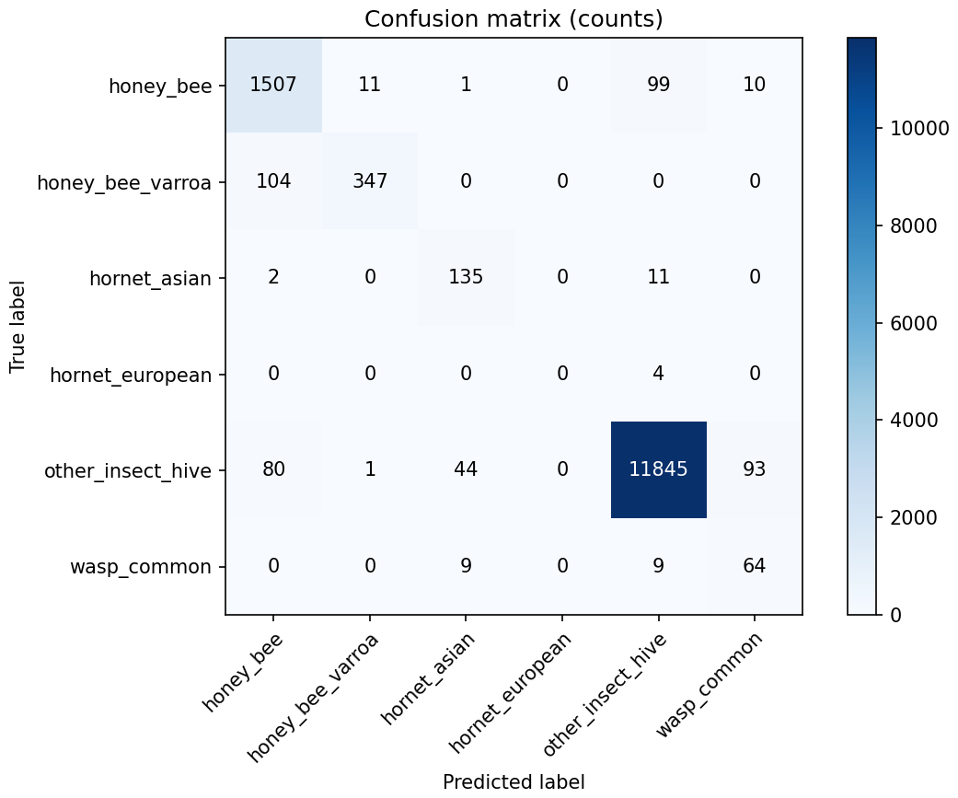
Confusion Structure of the Promoted Desktop Model
Key reading points
The strongest support and best behavior are concentrated in the dominant class: other_insect_hive.
honey_bee also shows strong and stable validation performance.
Lower-support classes such as hornet_european and wasp_common are more error-prone.
This explains why weighted scores remain high while macro scores remain more conservative.
The figure reinforces the thesis argument that rare-class performance must be interpreted cautiously.
Figure 5. Validation-split confusion-count matrix
Design and Evaluation of HiveSentinel AI: A Multi-Platform System for Bee Pest Monitoring | Muhammed Murat Yanaşoğlu | Master Thesis Defence
12

Slide 13
Diagnostic Example-Image Evaluation: Desktop vs Edge
Overall metrics (Table 12)
Latency summary (Table 14)
Pipeline | n | Accuracy | Macro F1 | Weighted F1 | Boundary
Desktop-local | 71 | 0.4085 | 0.3206 | 0.3251 | Example images only
Edge runtime | 71 | 0.4507 | 0.3479 | 0.3528 | Dev-host only; not Pi 4
Pipeline | Mean ms | Median ms | P95 ms
Desktop-local | 42.91 | 29.71 | 114.67
Edge runtime | 14.09 | 8.86 | 34.71
Current reading:
• In the development-host example-image run, the edge runtime is faster than the desktop-local CPU example evaluation.
• This does not substitute for physical Raspberry Pi 4 field timing.
Interpretation:
• These 71-image results are diagnostic example-image checks, not official held-out test-set benchmarks.
• The edge runtime slightly exceeds the desktop-local example-image accuracy on this curated folder set.
• The thesis explicitly warns that statistical and practical interpretation must remain cautious.
Design and Evaluation of HiveSentinel AI: A Multi-Platform System for Bee Pest Monitoring | Muhammed Murat Yanaşoğlu | Master Thesis Defence
13

Slide 14
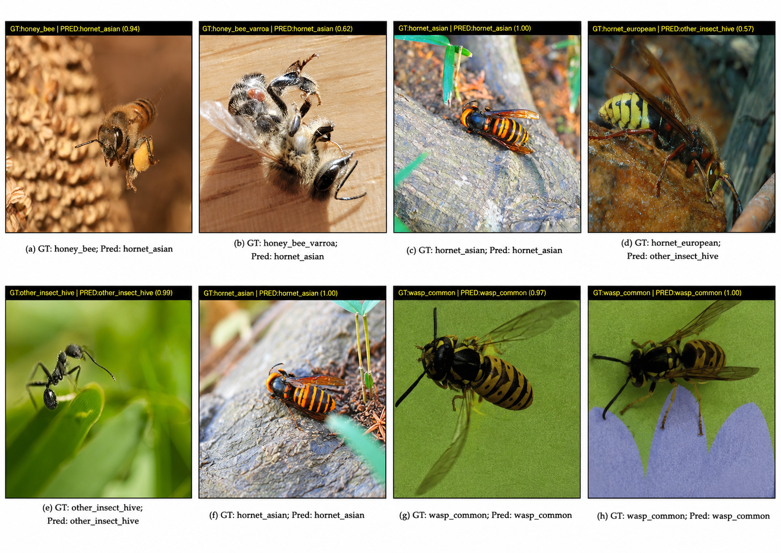
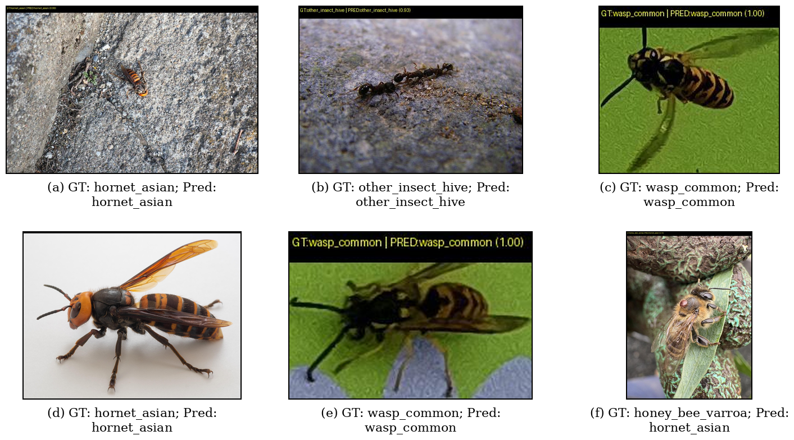
Representative Example Predictions
Figure 10 and Figure 11 from the thesis
Figure 10. Desktop-local example predictions
Figure 11. Edge-runtime example predictions
Representative desktop-local example predictions with ground-truth and predicted labels.
Representative low-resource edge-runtime example predictions under development-host evaluation.
Design and Evaluation of HiveSentinel AI: A Multi-Platform System for Bee Pest Monitoring | Muhammed Murat Yanaşoğlu | Master Thesis Defence
14

Slide 15
Performance, Stress Testing, and Safeguarded Edge Behavior
Stress and edge API summaries
Interpretation
Stress probe (Table 15)
Paced edge API (Table 16)
• In the development-host example-image run, the edge runtime is faster than the desktop-local CPU example evaluation.
• Burst-rate probing demonstrates controlled rejection behavior (HTTP 429), which protects service stability.
• The edge API can abstain (unknown) when confidence is below the configured policy threshold.
Average
~2849.3 ms
Total images
71
Median
~2773.8 ms
Completed successfully
71
Approx. P95
~3352.4 ms
Exact label matches
26
Max
~3657.4 ms
Abstentions
30
Effective throughput
~0.35 req/s
Other labelled outcomes
15
Operational takeaways from Tables 15 and 16
• The development-host stress probe shows bounded throughput and controlled saturation under burst requests.
• HTTP 429 responses act as an intended safeguard rather than a failure indication.
• In paced operation, all 71 example-image requests completed successfully on the edge API.
• The abstention pathway preserves reliability by withholding a forced label when confidence is below the configured threshold.
Design and Evaluation of HiveSentinel AI: A Multi-Platform System for Bee Pest Monitoring | Muhammed Murat Yanaşoğlu | Master Thesis Defence
15

Slide 16
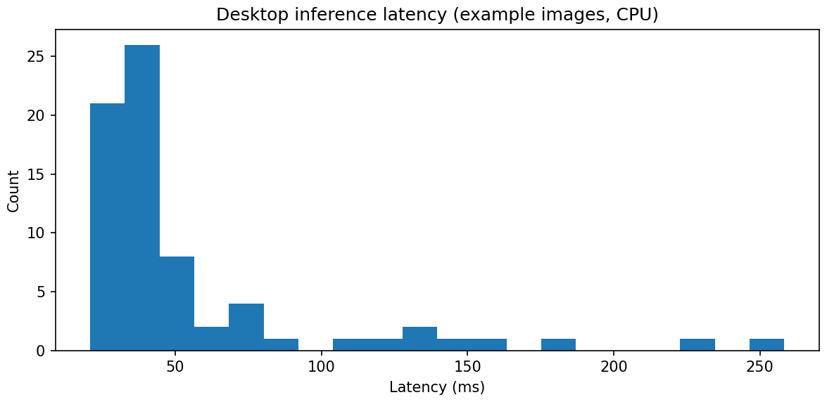
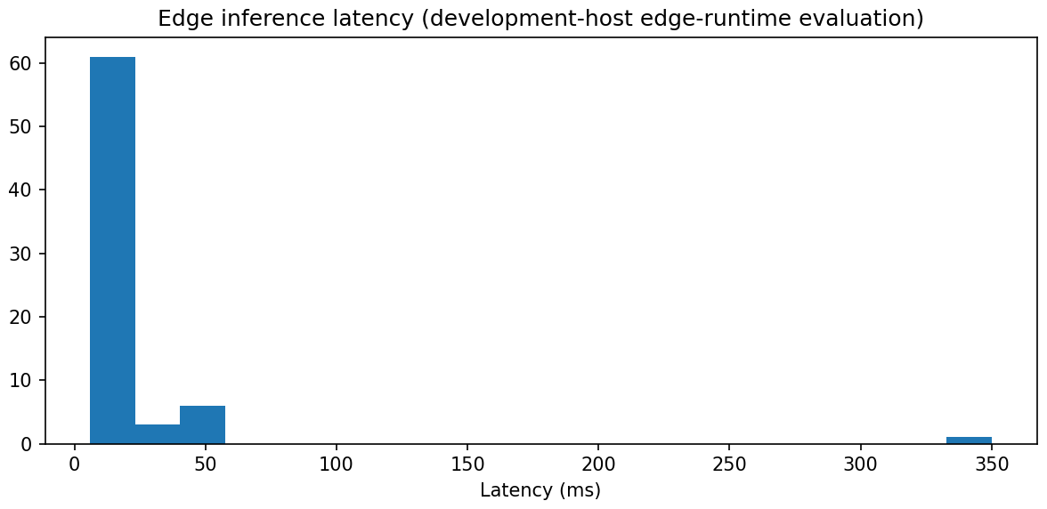
Detailed Performance Visuals
Figure 12. Desktop-local latency
Figure 13. Edge-runtime latency
Design and Evaluation of HiveSentinel AI: A Multi-Platform System for Bee Pest Monitoring | Muhammed Murat Yanaşoğlu | Master Thesis Defence
16

Slide 17
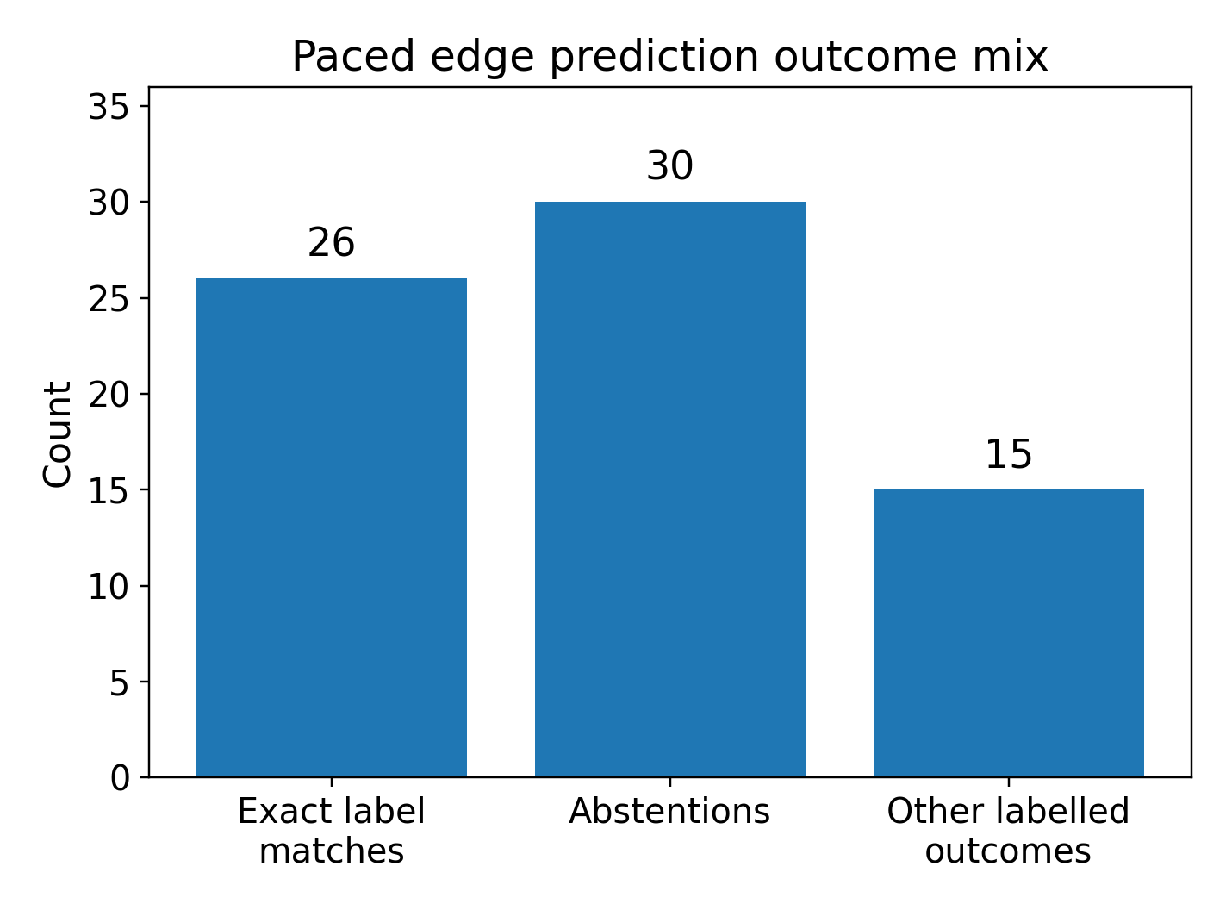
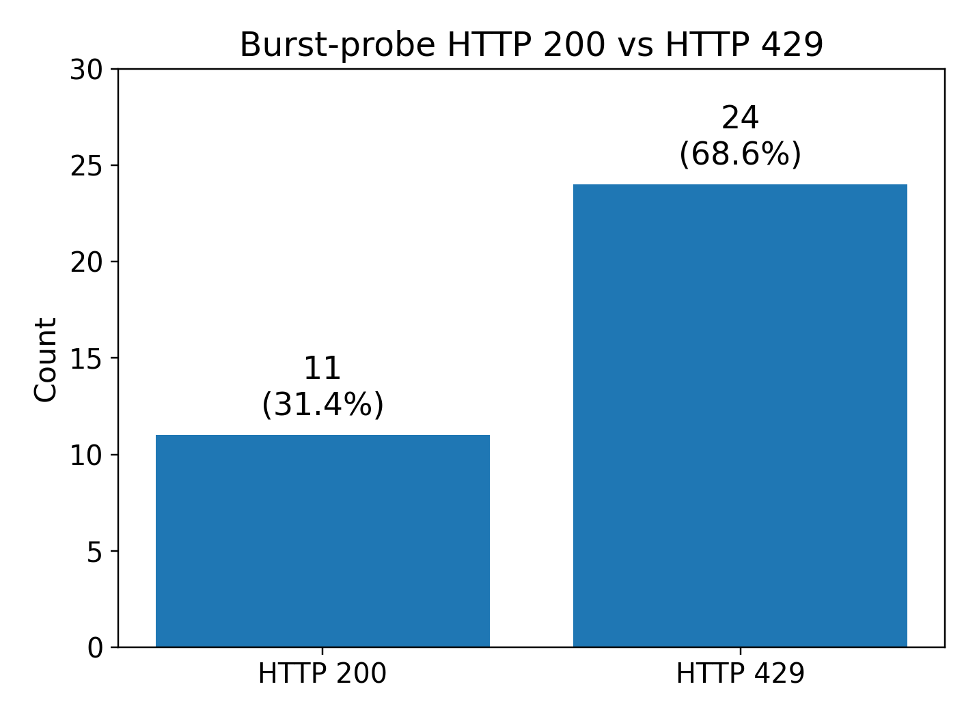
Edge Outcome Visuals
Figure 18. Outcome mix
Figure 19. HTTP 200 vs 429
Design and Evaluation of HiveSentinel AI: A Multi-Platform System for Bee Pest Monitoring | Muhammed Murat Yanaşoğlu | Master Thesis Defence
17

Slide 18
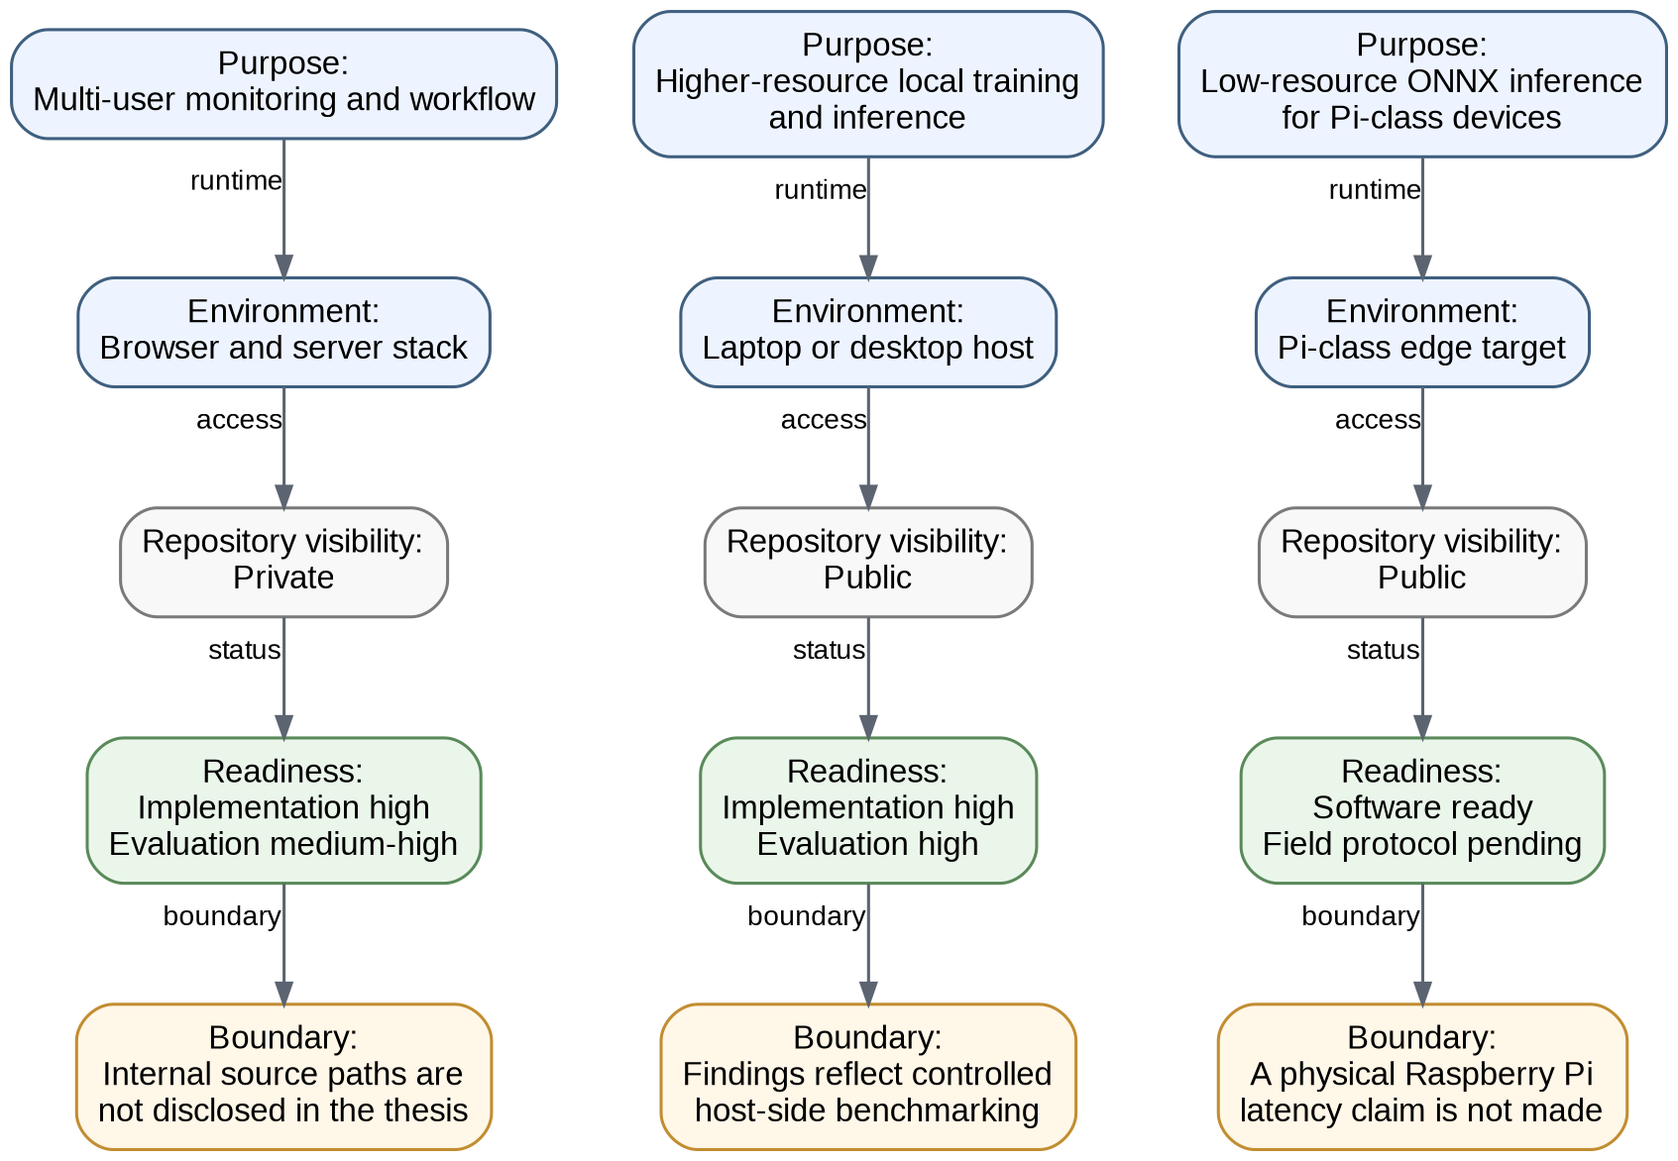
Evidence-to-Claim Logic and Deployment Readiness
Why this matters
The thesis distinguishes purpose, repository visibility, readiness evidence, and current boundary for each component.
Desktop evidence is strong at the host-side validation level.
Edge evidence supports software-host readiness but not yet physical Raspberry Pi 4 field legitimacy.
This boundary-setting is a central part of the scientific contribution of the thesis.
Figure 17. Three-platform deployment readiness comparison
Design and Evaluation of HiveSentinel AI: A Multi-Platform System for Bee Pest Monitoring | Muhammed Murat Yanaşoğlu | Master Thesis Defence
18

Slide 19
Comparison with Selected Related Studies
Evidence-bounded comparison adapted from Table 11
Study / system | Task | Main reported metric | Safe interpretation
HiveSentinel AI (desktop) | Six-class bee-pest classification | 0.96675 validation accuracy | Strong desktop validation result; not reported as held-out test accuracy
Liang (2024) | Bee health evaluation | 92.61% overall accuracy | Lower reported accuracy, but different task
Ratnayake et al. (2024) | Bee species identification | 90.18% accuracy | Domain-close comparator with lower reported accuracy
Narcia-Macias et al. (2023) | Hive-entrance monitoring | 96.28% tracking acc.; 0.95 F1 bee recognition | Very close comparator; task and metric differ
Vdoviak et al. (2025) | Hive-entrance detection | F1 up to ~93–95% | Relevant detector comparator under different hardware/task
O'Shea-Wheller et al. (2024) / VespAI | Invasive hornet detection | Mean precision-recall score ≥ 0.99 | Stronger narrow-task result; not a like-for-like broader framework comparison
Important caution: the thesis explicitly avoids presenting this as a single-metric leaderboard because tasks, datasets, and hardware conditions differ across studies.
Design and Evaluation of HiveSentinel AI: A Multi-Platform System for Bee Pest Monitoring | Muhammed Murat Yanaşoğlu | Master Thesis Defence
19

Slide 20
Discussion: Bounded Answers to the Research Questions
Interpretive linkage adapted from Table 18
RQ1
HiveSentinel AI demonstrates an integrated monitoring workflow across web, desktop-local, and edge-runtime layers.
Workflow completeness is shown through engineering evidence, not beekeeper field validation.
RQ2
The desktop-local classifier is most strongly supported by the Phase 3 validation-split evidence.
Example-image results are diagnostic only; rare-class behavior requires caution.
RQ3
The desktop-local and application layers show controlled API, stress, and latency evidence.
Values are environment-specific and should not be generalized to internet-scale or field deployments.
RQ4
The edge runtime demonstrates ONNX/Flask package readiness, rate-limited behavior, and abstain-capable prediction.
These are development-host results, not physical Raspberry Pi 4 field measurements.
RQ5
Remaining evidence requirements are clearly identified: public dataset release and physical Raspberry Pi 4 execution with logs/screenshots.
Until completed, dataset public availability and Pi 4 field performance remain pending.
Design and Evaluation of HiveSentinel AI: A Multi-Platform System for Bee Pest Monitoring | Muhammed Murat Yanaşoğlu | Master Thesis Defence
20

Slide 21
Limitations and Boundary Conditions
Central thesis principle: what is evidenced must be separated from what is still pending.
Not yet evidenced
Evaluation boundary
Physical Raspberry Pi 4 field latency, thermal behavior, and long-run stability are not reported as completed.
71-image desktop and edge results are diagnostic example-image checks, not official held-out test benchmarks.
Data-release boundary
Human-study boundary
The merged yolo_insects_multi dataset was not yet published with a public DOI/URL in the thesis evidence bundle.
No beekeeper usability study, clinical/regulatory validation, or commercial production-system benchmark is claimed.
These limitations do not remove the current contribution; they define the responsible scope of the contribution.
Design and Evaluation of HiveSentinel AI: A Multi-Platform System for Bee Pest Monitoring | Muhammed Murat Yanaşoğlu | Master Thesis Defence
21

Slide 22
Main Contributions and Future Work
Main contributions (Chapter VI)
Future work and recommendations
C1: Coupling model metrics with component-level application and runtime validation creates a hybrid evaluation structure.
C2: The thesis demonstrates the trade-off between safety controls and model accuracy in a low-resource edge setting.
C3: It separates validation-split metrics, example-image summaries, illustrative behavior, and edge timing to reduce over-claiming.
C4: It clearly defines what current software validation supports and what physical Raspberry Pi field validation still requires.
Publish the merged yolo_insects_multi dataset with a stable public URL/DOI and checksum validation.
Run and document physical Raspberry Pi 4 execution with latency, thermal, and power stability evidence.
Extend reliability analysis with calibration-aware evaluation (e.g., reliability diagrams and selective prediction metrics).
Improve rare-class behavior through structured augmentation or taxonomy revision.
Maintain synchronized validation records and updated result visualizations for future releases.
Design and Evaluation of HiveSentinel AI: A Multi-Platform System for Bee Pest Monitoring | Muhammed Murat Yanaşoğlu | Master Thesis Defence
22

Slide 23
Conclusion
1
HiveSentinel AI was developed as a multi-platform monitoring framework that integrates a web application, a desktop-local YOLOv8 pipeline, and an ONNX-first edge runtime.
2
The strongest full-split evidence in the thesis is the desktop-local Phase 3 validation result: 0.96675 top-1 accuracy on 14,376 validation images.
3
The thesis makes a defensible MSc-level contribution by combining implementation, validation, integration, and boundary-setting—while clearly reserving Raspberry Pi 4 field claims and human-centered validation for future work.
Final message: In applied monitoring systems, evidence discipline is part of the contribution.
Design and Evaluation of HiveSentinel AI: A Multi-Platform System for Bee Pest Monitoring | Muhammed Murat Yanaşoğlu | Master Thesis Defence
23

Slide 24
Thank You
Questions and Discussion
Muhammed Murat Yanaşoğlu
M.Sc. Thesis Defense
M.Sc. Artificial Intelligence Engineering | Near East University
Student Number: 20245073
https://muratyanasoglu.com/ | 20245073@std.neu.edu.tr | eng.muratyanasoglu@gmail.com | +905338324602

